Slide 1
Task 1
FMP Research

Slide 2
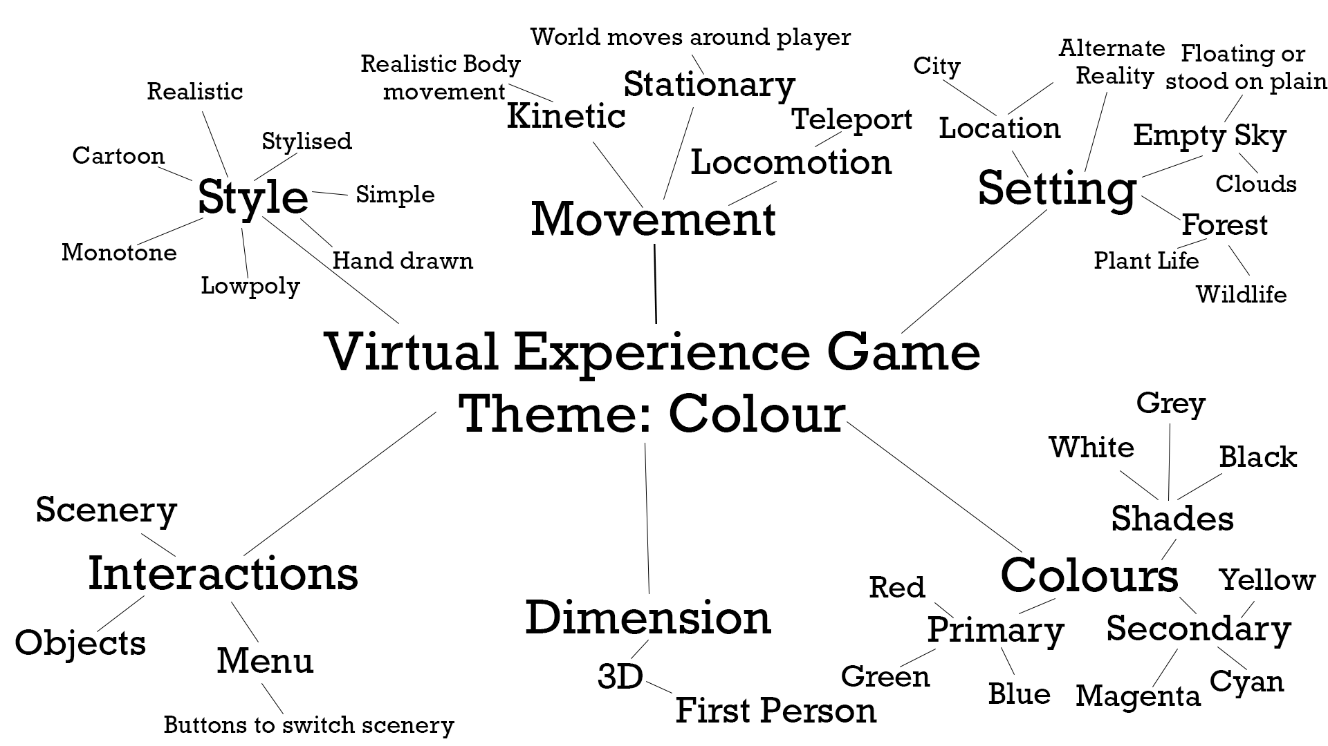
FMP Research
Idea 1 Mind map
My first idea was thinking about making a VR virtual experience game with the theme of colour. My aim for the game would be to link colours with emotions and feelings.

Slide 3
FMP Research
Idea 1 S.W.O.T
S.W.O.T Project:
S: One of the strengths of this idea is that it would be relatively easy to do in the time frame that I have.
W: A weakness of the idea is that it may be to simple. The aim would be to have at least 4 scenes with each having its own colour but this wont take long to do so I could always add In more scenes if a have spare time.
O: This Idea would give me the chance to test out my skill in making a game with nothing to explain but the player knows what its about.
T: A threat of this idea is that it may be hard trying to make a simple games that makes the player change the way they feel by being in a different scene.
S.W.O.T Personal:
S: This idea will be easy for me to do because it will be a simple world scene that just changes to what the player wants.
W: A weakness of mine that could affect the production of this idea, would be me being indecisive of what I would in each scene. For example, making the world red to represent anger would give me lots of options of what I could put in that scene to make the player feel anger.
O: This idea gives me a chance to make something that would be similar to what I want to do in the future.
T: A big threat of this idea is that it may be like what I want to do in the future, but this idea doesn't motivate me to want to do it.

Slide 4
FMP Research
Idea 1 Conclusion
This idea would take a lot of research into how colours can effect peoples emotions. A lot of scientific papers on how it works. My job would be on how to implement that into a game.
If I was to do this idea then I think I would be able to get it done in the time frame I have. Each scene I could spend on week on making and perfecting it, and with my spare time maybe adding more scenes and detail.
The main colours I could use are:
Red (anger)
Green (balance)
Blue (peace)
White (blank/nothing)
Black (darkness/depression)
These colours would be easy to make worlds for. All I would have to do its add in objects and scenery to enhance on these colours. For example adding trees for green, having clouds for blue and having destruction all over the world for red.
This idea could work but getting it exactly as I would want it will be hard.

Slide 5
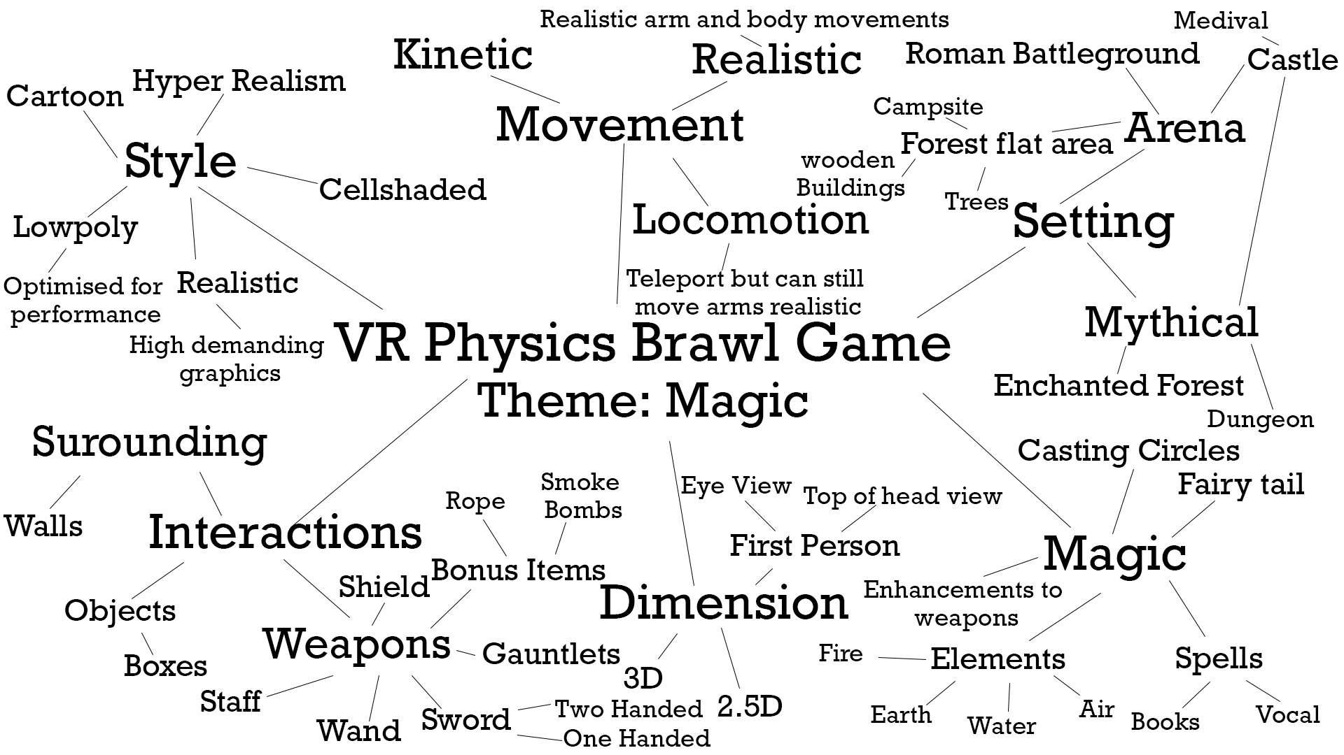
FMP Research
Idea 2 Mind map
My second idea is a VR fighting game based on magic with realistic physics. The aim of this idea would be to make a realistic fighting VR game with the theme being magic.

Slide 6
FMP Research
Idea 2 S.W.O.T
S.W.O.T Project:
S: This idea would help me learn how to represent movement in VR games, both locomotion and kinetic. The weapons I would need would also have many ways of using them, like using a sword would be different to using a dagger.
W: A weakness of this idea is that it will require a lot of detailed coding to get the ai enemy working and for how collision works. If I did go with realistic physics than I would also have to create that from scratch.
O: This idea gives me the opportunity to make a fighting game that I would enjoy playing. Like others but with more of a magic theme.
T: The main threat to this idea is that it will take a long time getting everything right, a lot of research into body movement and physics.
S.W.O.T Personal:
S: A strength of mine for this project is that I like designing and making weapons and that I know a lot about magic and wizardry, I can use this knowledge and put it into the game.
W: A weakness of mine that would affect this idea is that I will most likely spend more time on the environment rather than the player character, which is bad because the way the player is a moves is the most important part in a fighting style game.
O: This idea would allow to test out using weapons in games and to learn more about body movement.
T: A threat of mine for this idea is that i will do a lot of work all at once and then take a break which will mean that I have lost all the original ideas that I had. I will end up doing all the research then get burned out when it comes to putting that research to use.

Slide 7
FMP Research
Idea 2 Conclusion
This idea would be good for a future project for myself when I have more time.
The research I would have to do for this idea is:
Body movement/physics
Weapons
Fighting styles
Magic styles/Elements
Because the game requires movement I'm worried of people damaging there surrounding when they swing a sword or something. I do like the idea but I feel like I will get unmotivated to do it before I start doing the practical work.

Slide 8
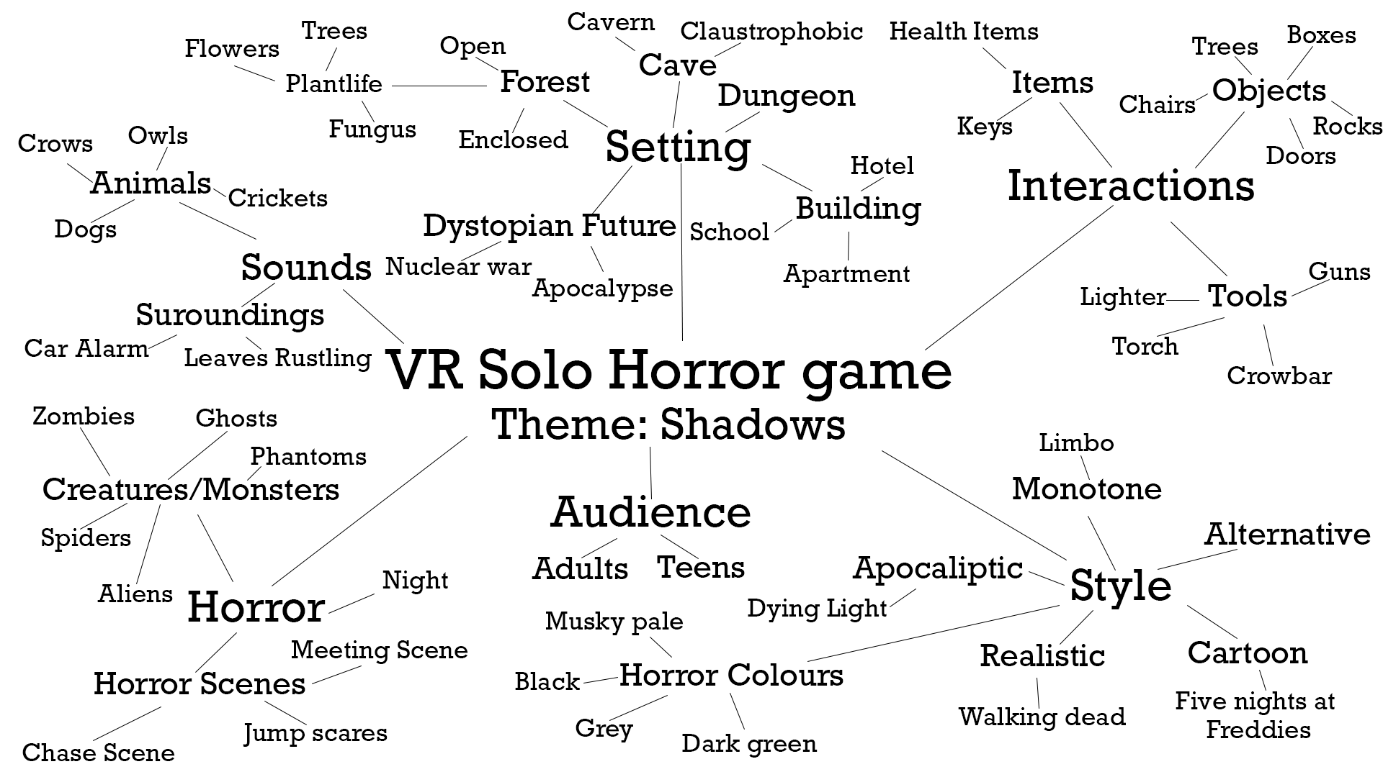
FMP Research
Idea 3 Mind map

Slide 9
FMP Research
Idea 3 S.W.O.T
S.W.O.T Project:
S: A strength of this idea is that I like horror games that are different from other games
W: A weakness is that creating a whole game with story and a well-made environment take a long time to make and with the time I have I don’t think I'm going to be able to make a quality game.
O: This idea gives me the opportunity to try make something new, I've made a city environment but not a forest specifically for horror
T: A threat of this idea is that I may set to much upon myself because I don’t want this game to be a simple horror like others where it’s based in a forest, something is chasing you and then you escape it. I would like for mine to be more than that.
S.W.O.T Personal:
S: A strength of mine for this idea is that I have seen and played a lot of horror games, so I feel like I know how to import that knowledge into this game. Another strength is that I prefer working with nighttime environments.
W: A weakness of mine that will affect this idea is that I may spend to long on the environment and not enough on the story and implementing that story into the surrounding.
O: This idea gives me the opportunity to test out my skills in both environment buildings and objects. This time I can try model my own trees and other plants unlike last time where I found a free pack online.
T: A threat for this idea is of how big it is. A fully working VR horror game with a longish story will take a long time to make, and a lot of effort.

Slide 10
FMP Research
Idea 3 Conclusion
I think this idea is my best choice because I have done much more research into than the others. I don’t want this game to be a similar to other so I may try a different style. 1 idea I had is making the world illuminated so everything glows in a night time world. I think I can improve the horror aspect with this because I could make the main enemy a shadow that you cant see but it affect the glow when it touches it.
Because my environment is a forest I could make the only glowing parts the plant life and the animals, the pathway could just dark but is lit up by the trees around it.
With the time I have I think I could make this VR game how I would want it to be. Prioritise the practical work and less of the research but still enough to show that I have done a good amount of research. VR games will require a lot of testing so I will have to leave some time in the day for that.
I'm going to go with this idea of a VR horror game based in a forest that is all glowing. My theme of Shadows also works with the glowing part because it makes it harder to see the enemy

Slide 11
FMP Research
Chosen theme research
The research I am going to do for this idea is:
Horror Games
VR Games
Shadows and history
Plants/glowing plants
Glowing animals
I will look at other horror games to see of how they used horror with there environments. Games like The Blair witch I will use as reference because they both use there environment to create atmosphere.
Research into shadows shows me what makes people so scared of them and also the fear of not being able to see what is there. I can use this research to add to the horror aspect of my game.
I would like to add real glowing plants into my environment. Some plants and mushrooms do give off some light which I would like to use. Similar to some animals that also glow, I would like to use these to add more to the environment
A main thing I will research is how to make a VR game and how to use the VR aspect to the game advantage. Like hearing something but you cant see it.

Slide 12
FMP Research
Exploration of concept related to chosen theme
With my theme being shadows I'm going to represent this by having the enemy as a shadow that affects the glow around it. The shadow will float around over the glowing grass so you can sort of tell where it is. With my world being all illuminated there will be a lot of shaded places in the world. I could represent which way the player has to go by it being a path of light. Anywhere that is all dark could be a danger zone and the enemy instantly finds you, which teaches the player to stay in the light.
I may give the player a torch to make it feel like they can help themselves but it can only be used for a couple seconds at a time. The only bad thing about this is that it will take away the light of the world around the player.
I want to make the player think that being in light is safe and anything that is dark means that the enemy is there.

Slide 13
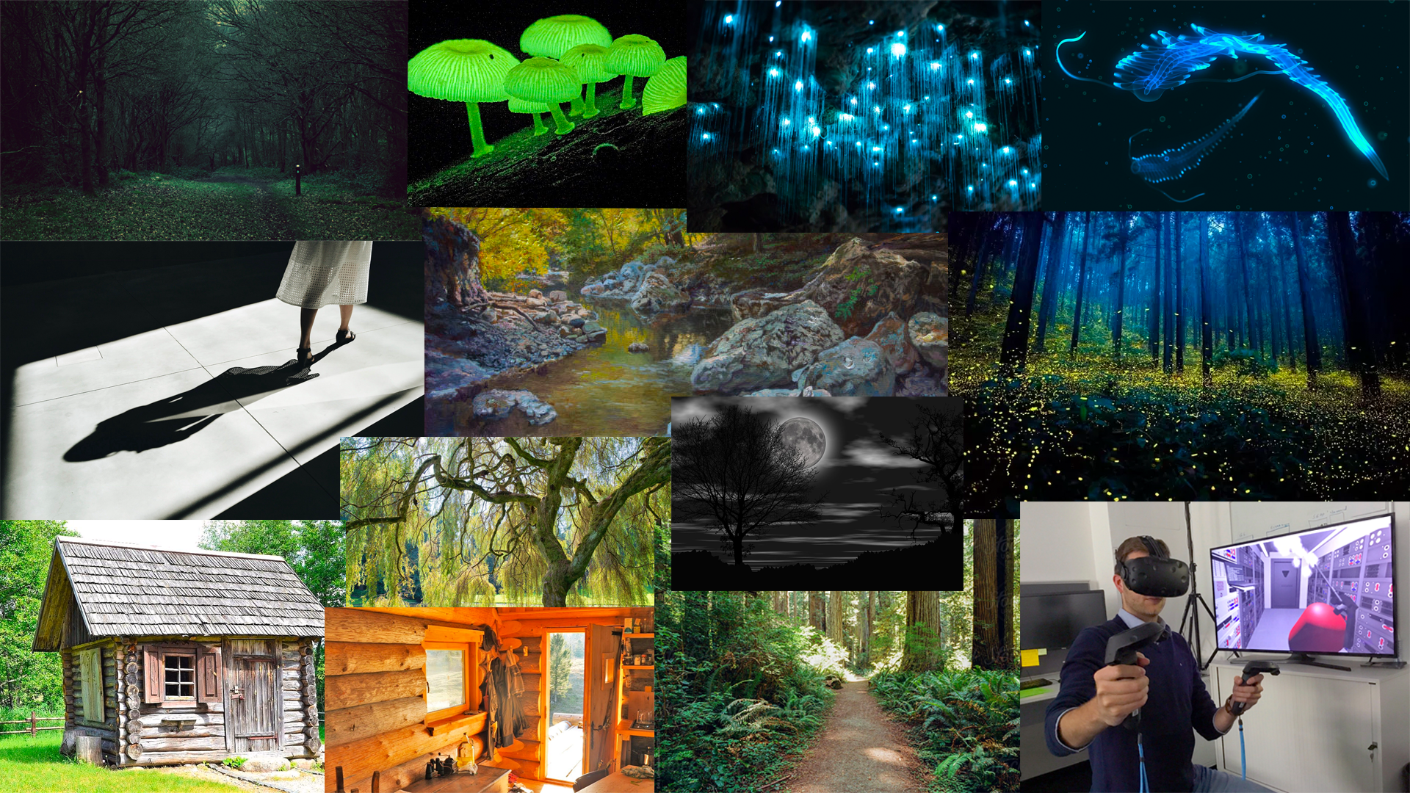
FMP Research
Mood board ‘intended’ design annotated
Since I'm going to add a river to my world I may as well add in oceanic animals that can glow.
Can have mushrooms around the pathway to show where it is. Also to add more diverse plant life in the world
Reference for the wooden cabin in my game.
Because I want the forest to still be scary I'm going to do a mixture of willow trees and normal oak trees
I need to keep in mind that this is going to be a VR game and not a normal pc game, the controls and how its perceived will be different from normal

Slide 14
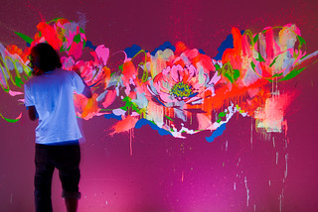
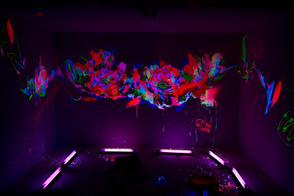
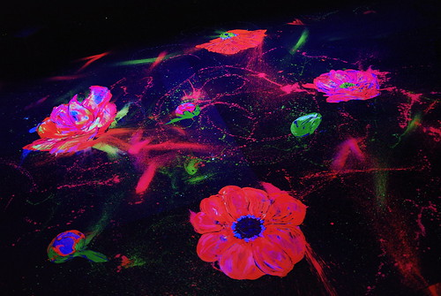
FMP Research
Artist Research
Que Houxo
Que Houxo also known as Questa is a artist based in Tokyo Japan most well known for his fluorescent paintings and installations using black light. He started his career in paintings in 1999 with a background in wall graffiti. His main series of works is called “Day and Night” which reference flowers frequently.
Que Houxo (2009) Dezzart. Available at https://www.flickr.com/photos/day_and_night/albums/72157613116278197/with/3239106352/ (Accessed: 22 Apr 2021)
I really like of how he represents flowers in his work, making them so bright and colourful. The may he uses light and dark colours to give the painting more depth. The brightness of the petals glowing in the dark background. I would like to try do something for the way I make my world my illuminated.
Looking at his artwork it has give me the idea of adding flowers in to the foliage of my environment. I could use glowing red Poppy's on the ground and glowing pink Lilies on the river.
Que Houxo (2009) Laforet. Available at https://www.flickr.com/photos/day_and_night/albums/72157616373710021/with/3421295108/ (Accessed: 22 Apr 2021)

Slide 15
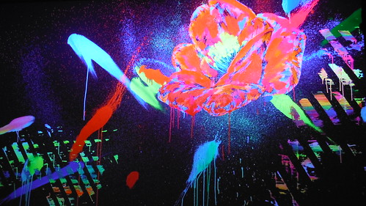
I like the way he uses the orange for the petals, the blue to give it depth and the green as the Pistil.
Since because my grass is going to be a mix of green and blue I think adding in red/orange or pink flowers will add some contrast of colour to the world.
Que Houxo (2013) CHOTTOMATTE. Available at https://www.flickr.com/photos/day_and_night/albums/72157635037661309/ (Accessed: 22 Apr 2021)
In my environment I could make the torch a black light torch but that would mean that it would not be bright for the player to see. If I did do this Idea than I could also make it so the player can see finger prints and foot prints from the enemy to see if it has been there or not. This idea would be cool to add but I think it would take to long to make work which would take time away from more important things.

Slide 16
FMP Research
Chosen idea conclusion
I am aiming to make a VR Horror game based on the theme of shadows. It is going to be based in world of illumination where everything glows. The environment is going to be a forest with a river going through. I am going to make the enemy a shadow that follows the player and affects the luminance around it.
Since it is going to be a VR game, I will make objects interactable in the game, there will also be some tools that the player can use and hold in their hands.
I want at least 3 scenes in the game, the entrance scene, something happens in the middle and the end scene of getting away. I think this should be enough for what I want to have in the game. I would like for the focus to be on the environment. I could add more if I have extra time.

Slide 17
FMP Research
Gant Chart
Tasks: | Start day: | End Date: | Duration:
Research | 19.04.21 | 10.06.21 | 52 days
Planning | 19.04.21 | 21.04.21 | 3 days
Designing map | 20.04.21 | 21.04.21 | 1 day
Blocking out | 21.04.21 | 23.04.21 | 2 days
Beta World | 23.04.21 | 26.04.21 | 3 days
Story planned out | 23.04.21 | 27.04.21 | 4 days
Actual world layout | 26.04.21 | 28.04.21 | 2 days
World foliage | 28.04.21 | 30.04.21 | 2 days
Animals | 30.04.21 | 03.05.21 | 3 days
Enemy/enemy A.I | 03.05.21 | 06.05.21 | 3 days
Playable game | 06.05.21 | 10.05.21 | 4 days
Scene 1 | 10.05.21 | 12.05.21 | 2 days
Scene 2 | 12.05.21 | 19.05.21 | 7 days
Scene 3 | 19.05.21 | 21.05.21 | 2 days
Scene 4 | 21.05.21 | 24.05.21 | 3 days
Bug Fixing | 26.05.21 | 31.05.21 | 5 days
Extra time | 31.05.21 | 09.06.21 | 10 days

Slide 18
Bibliography:
Que Houxo Portfolio
https://www.flickr.com/photos/day_and_night/albums/with/72157635037661309

